Slide 1
Views, Layouts and resources for the UI
Day 2

Slide 2
Contents
Views, view groups, and view hierarchy
Layouts in XML and Java code
Event handling
Resources
Screen measurements
Text and Scrolling View

Slide 3
Views

Slide 4
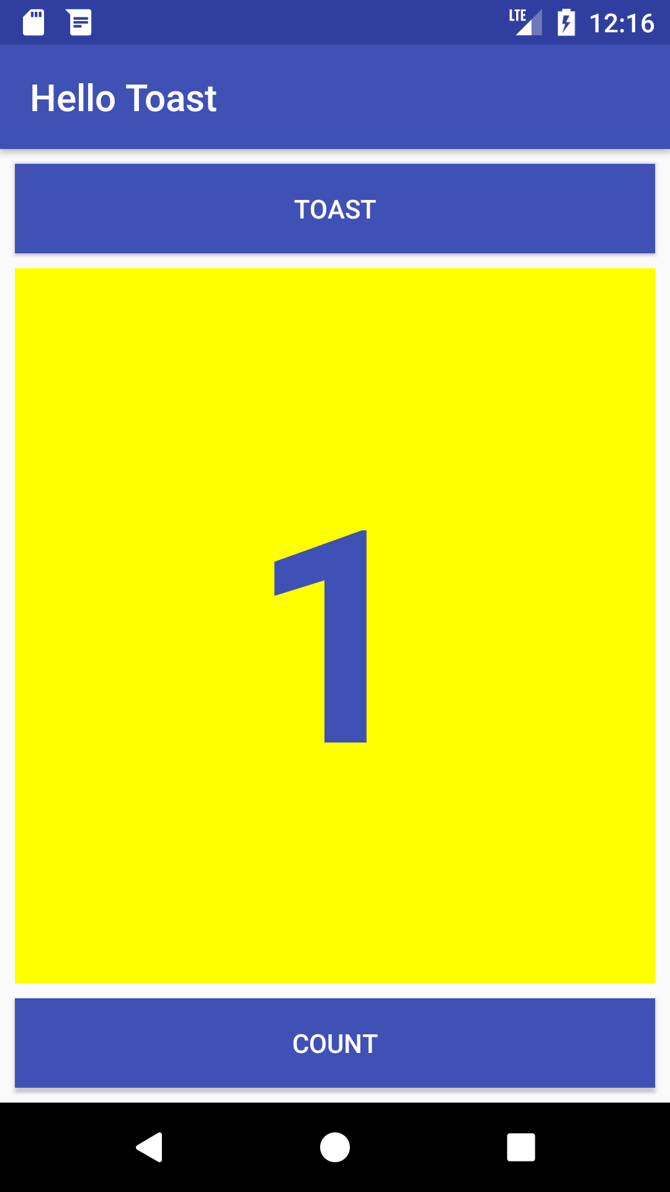
Everything you see is a view
If you look at your mobile device,
every user interface element that you see is a View.
Views

Slide 5
What is a view?
View subclasses are basic user interface building blocks
Display text (TextView class), edit text (EditText class)
Buttons (Button class), menus, other controls
Scrollable (ScrollView, RecyclerView)
Show images (ImageView)

Slide 6


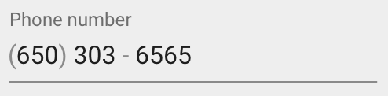

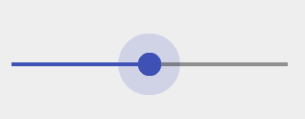

Examples of view subclasses
Button
EditText
Slider
CheckBox
RadioButton
Switch

Slide 7
VIEWs HAVE PROPERTIES
Have properties (e.g. Color, dimensions, positioning)
May have focus (e.g., selected to receive user input)
May be interactive (respond to user clicks)
May be visible or not
Relationships to other views

Slide 8
Create views and layouts
Android Studio layout editor: visual representation of XML
XML editor
Java code

Slide 9
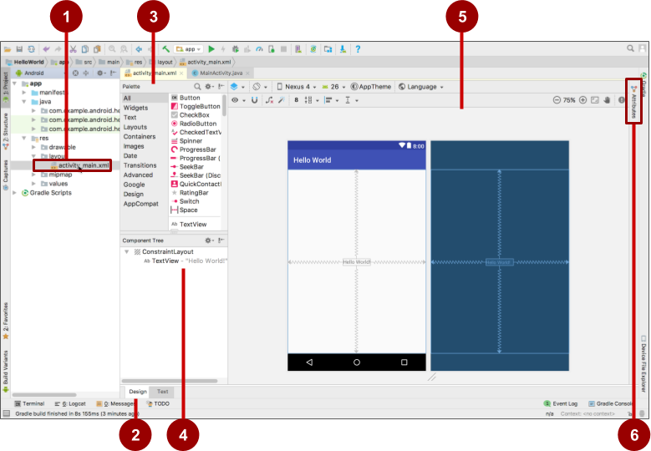
Android Studio layout editor
XML layout file
Design and Text tabs
Palette pane
Component Tree
Design and blueprint panes
Attributes tab

Slide 10
View defined in XML
<TextView
android:id="@+id/show_count"
android:layout_width="match_parent"
android:layout_height="wrap_content"
android:background="@color/myBackgroundColor"
android:text="@string/count_initial_value"
android:textColor="@color/colorPrimary"
android:textSize="@dimen/count_text_size"
android:textStyle="bold"
/>

Slide 11
View attributes in XML
android:<property_name>="<property_value>"
Example: android:layout_width="match_parent"
android:<property_name>="@<resource_type>/resource_id"
Example: android:text="@string/button_label_next"
android:<property_name>="@+id/view_id"
Example: android:id="@+id/show_count"

Slide 12
Create View in Java code
context
In an Activity:
TextView myText = new TextView(this);
myText.setText("Display this text!");

Slide 13
What is the context?
Context is an interface to global information about an application environment
Get the context:
Context context = getApplicationContext();
An Activity is its own context: TextView myText = new TextView(this);

Slide 14
ViewGroup and View hierarchy

Slide 15
ViewGroup contains "child" views
A ViewGroup(parent) is a type of view that can contain other views(childs).
ViewGroup is the base class for layouts and view containers.
LinearLayout: arrange views in horizontal/ vertical row
ScrollView: scrollable view that contains one child view
RecyclerView: Contains a list of elements and enables scrolling by adding and removing elements dynamically

Slide 16
ViewGroups for layouts
Layouts
are specific types of ViewGroups (subclasses of ViewGroup)
contain child views
can be in a row, column, grid, table, absolute

Slide 17




Common Layout Classes
LinearLayout
RelativeLayout
GridLayout
TableLayout

Slide 18
Common Layout Classes
ConstraintLayout: Connect views with constraints
LinearLayout: Horizontal or vertical row
RelativeLayout: Child views relative to each other
TableLayout: Rows and columns
FrameLayout: Shows one child of a stack of children

Slide 19
Hierarchy of viewgroups and views
ViewGroup
Root view is always a ViewGroup
ViewGroup
View
View
View
View
View

Slide 20
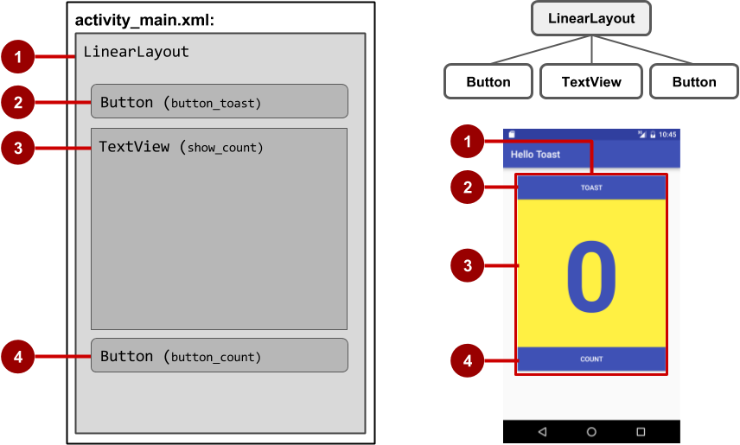
View hierarchy and screen layout

Slide 21
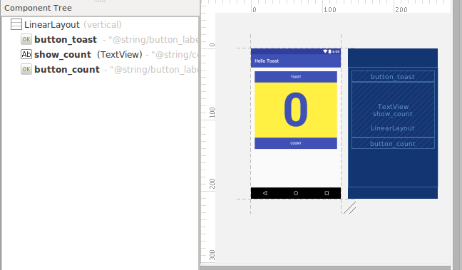
View hierarchy in the layout editor

Slide 22
Layout created in XML
<LinearLayout
android:orientation="vertical"
android:layout_width="match_parent"
android:layout_height="match_parent">
<Button
... />
<TextView
... />
<Button
... />
</LinearLayout

Slide 23
Layout created in Java Activity code
LinearLayout linearL = new LinearLayout(this);
linearL.setOrientation(LinearLayout.VERTICAL);
TextView myText = new TextView(this);
myText.setText("Display this text!");
linearL.addView(myText);
setContentView(linearL);

Slide 24
Set width and height in Java code
Set the width and height of a view:
LinearLayout.LayoutParams layoutParams =
new Linear.LayoutParams(
LayoutParams.MATCH_PARENT, LayoutParams.MATCH_CONTENT);
myView.setLayoutParams(layoutParams);

Slide 25
The layout editor and Constraint Layout

Slide 26
Event Handling

Slide 27
Events
Something that happens
In UI: Click, tap, drag
Device: DetectedActivity such as walking, driving, tilting
Events are "noticed" by the Android system

Slide 28
Event Handlers
Methods that do something in response to a click
A method, called an event handler, is triggered by a specific event and does something in response to the event

Slide 29
Attach in XML and implement in Java
Attach handler to view in XML layout:
android:onClick="showToast"
Implement handler in Java activity:
public void showToast(View view) {
String msg = "Hello Toast!";
Toast toast = Toast.makeText(
this, msg, duration);
toast.show();
}
}

Slide 30
Alternative: Set click handler in Java
Button button = (Button) findViewById(R.id.button_id);
button.setOnClickListener(new View.OnClickListener() {
public void onClick(View v) {
String msg = "Hello Toast!";
Toast toast = Toast.makeText(this, msg, duration);
toast.show();
}
});

Slide 31
Resources

Slide 32
Resources
Separate static data from code in your layouts.
Strings, dimensions, images, menu text, colors, styles
Useful for localization

Slide 33
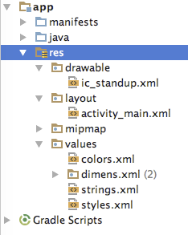
Where are the resources in your project?
resources and resource files
stored in res folder

Slide 34
Refer to resources in code
Layout:
R.layout.activity_main
setContentView(R.layout.activity_main);
View:
R.id.recyclerview
rv = (RecyclerView) findViewById(R.id.recyclerview);
String:
In Java: R.string.title
In XML: android:text="@string/title"

Slide 35
Measurements
Density-independent Pixels (dp): for Views
Scale-independent Pixels (sp): for text
Don't use device-dependent or density-dependent units:
Actual Pixels (px)
Actual Measurement (in, mm)
Points - typography 1/72 inch (pt)

Slide 36
Text and Scrolling ViewS

Slide 37
TextView for text
TextView is View subclass used for displaying for single and multi-line text
EditText is TextView subclass with editable text
Controlled with layout attributes
Set text:
Statically from string resource in XML
Dynamically from Java code and any source

Slide 38
Creating TextView in XML
<TextView android:id="@+id/textview"
android:layout_width="match_parent"
android:layout_height="wrap_content"
android:text="@string/my_story"/>

Slide 39
Common TextView attributes
android:text—text to display
android:textColor—color of text
android:textAppearance—predefined style or theme
android:textSize—text size in sp
android:textStyle—normal, bold, italic, or bold|italic
android:typeface—normal, sans, serif, or monospace
android:lineSpacingExtra—extra space between lines in sp

Slide 40
Formatting active web links
<string name="article_text">... www.hibretech.com ...</string>
<TextView
android:id="@+id/article"
android:layout_width="wrap_content"
android:layout_height="wrap_content"
android:autoLink="web"
android:text="@string/article_text"/>
autoLink values:"web", "email", "phone", "map", "all"

Slide 41
Creating TextView in Java code
TextView myTextview = new TextView(this);
myTextView.setWidth(LayoutParams.MATCH_PARENT);
myTextView.setHeight(LayoutParams.WRAP_CONTENT);
myTextView.setMinLines(3);
myTextView.setText(R.string.my_story);
myTextView.append(userComment);

Slide 42
ScrollView

Slide 43
What about large amounts of text?
News stories, articles, etc…
To scroll a TextView, embed it in a ScrollView
Only one View element (usually TextView) allowed in a ScrollView
To scroll multiple elements, use one ViewGroup (such as LinearLayout) within the ScrollView

Slide 44
ScrollView for scrolling content
ScrollView is a subclass of FrameLayout
Holds all content in memory
Not good for long texts, complex layouts
Do not nest multiple scrolling views

Slide 45
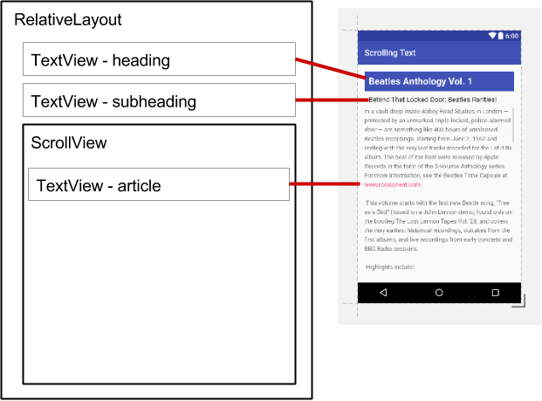
ScrollView layout with one TextView
<ScrollView
android:layout_width="wrap_content"
android:layout_height="wrap_content"
android:layout_below="@id/article_subheading">
<TextView
android:layout_width="wrap_content"
android:layout_height="wrap_content"
.../>
</ScrollView>

Slide 46
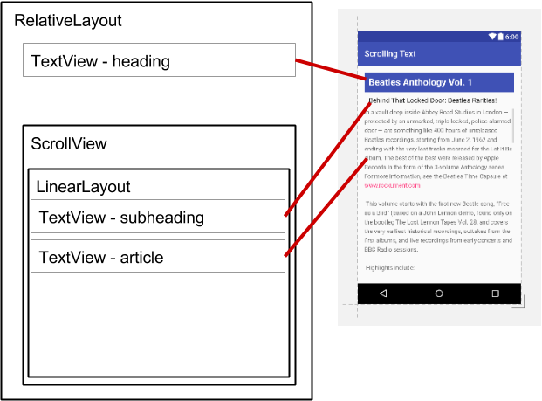
ScrollView layout with a view group
<ScrollView ...
<LinearLayout
android:layout_width="match_parent"
android:layout_height="wrap_content"
android:orientation="vertical">
<TextView
android:id="@+id/article_subheading" .../>
<TextView
android:id="@+id/article" ... />
</LinearLayout>
</ScrollView>

Slide 47
ScrollView with image and button
<ScrollView...> <LinearLayout...> <ImageView.../> <Button.../> <TextView.../> </LinearLayout> </ScrollView>
One child of ScrollView which can be a layout
Children of the layout

Slide 48
END

